Slide 1
Final Presentation
Kweku White & TJ Tracy
1

Slide 2
Formula 1: Context
Formula 1 is the highest level of international racing.
The environment is highly competitive.
Drivers and teams will seek out any advantage possible.
A lot of money goes into a Formula 1 team.
If you do not perform, you are out.
2

Slide 3
Formula 1: How It Works
There are 22 Grand Prixs, 20 drivers, and 10 teams.
On any race weekend there are practice sessions Friday, qualifying Saturday, and the race on Sunday.
In qualifying, every driver goes for their fastest lap. Where you place out of the 20 drivers is where you will start on the grid on Sunday.
1st place gets 25 points, and 18,15,12,10,8,6,4,2,1 as the position decreases.
Anyone who does not finish or finishes lower than 10th gets 0 points on their record.
3

Slide 4
Formula 1: Winning
There are two ways to win:
Winning the drivers championship
Winning the constructors championship
The driver at the end of the season with the most points wins the drivers championship.
The team at the end of the season with the most points wins the constructors championship.
4

Slide 5
Project: Objective & Data
The objective of the project is to implement data mining techniques to derive insight from Formula 1 data.
The dataset contains input from 1950 to the end of the 2017 season.
Attributes in the dataset include…
Grid, Position, Fastest Lap
Time to finish, Team Name, Team Nationality
Driver Name, Driver Nationality, Year
Round, Name of the race, Location of the race
Number of pit stops, Length of pit stop, Lap of pit stop
5

Slide 6
Project: Implementation
To derive insight from the Formula 1 data, two approaches are taken.
Logistic Approach:
Create binomial attribute signifying if the driver finished the race.
Build Model
Apply Model
Neural Network Approach:
Change character attributes to factors
Build Model
Apply Model
6

Slide 7
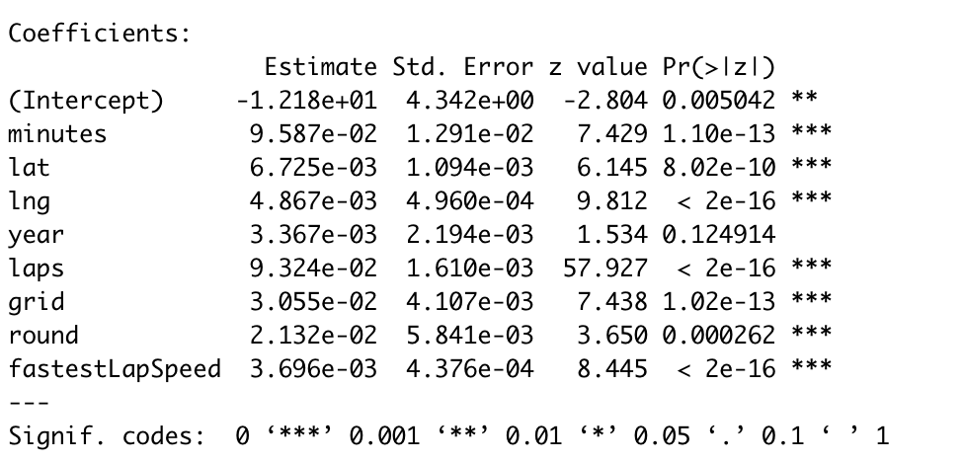
Project: Logistic Model
Finished = β0 + β1minutes + β2lat + β3lng+ β4year + β5laps + β6grid + β7round + β8fastestLapSpeed + ε
8

Slide 8
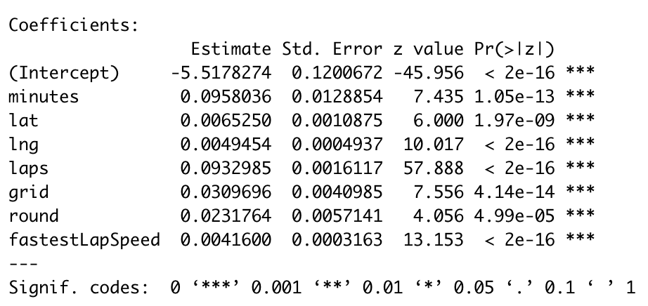
Project: Logistic Model
Finished = β0 + β1minutes + β2lat + β3lng + β4laps + β5grid + β6round + β7fastestLapSpeed + ε
7

Slide 9
Project: Neural Network Model
Position = grid + laps + minutes + fastestLapSpeed + constructor_nationality
+ driver_nationality + round + country + name + circuit_time
1) The size of the neural network is two and the max iterations is 10000.
2) The final status of the car, pit stops, and fastest lap time are omitted.
9

Slide 10
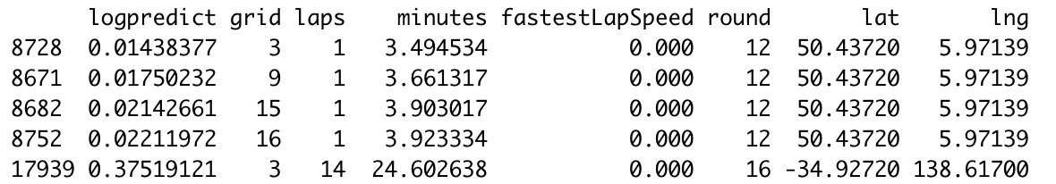
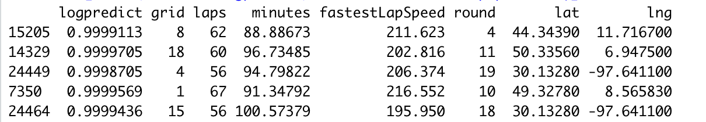
Project: Logistic Model Results
Bottom 5 Results from Test Data
Top 5 Results from Test Data
10

Slide 11
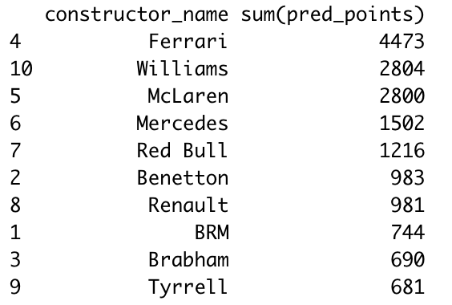
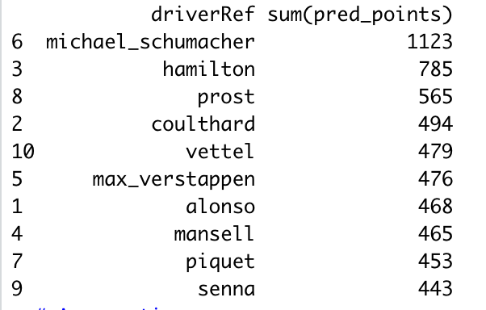
Project: Neural Network Results
Top 10 Predicted Teams
Top 10 Predicted Drivers
11

Slide 12
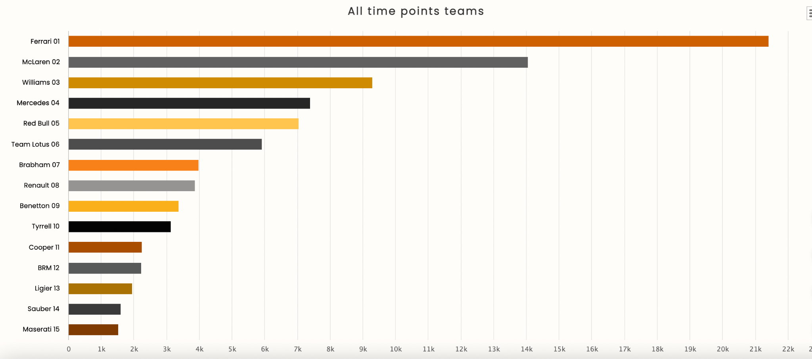
Top 10: Constructors

Slide 13
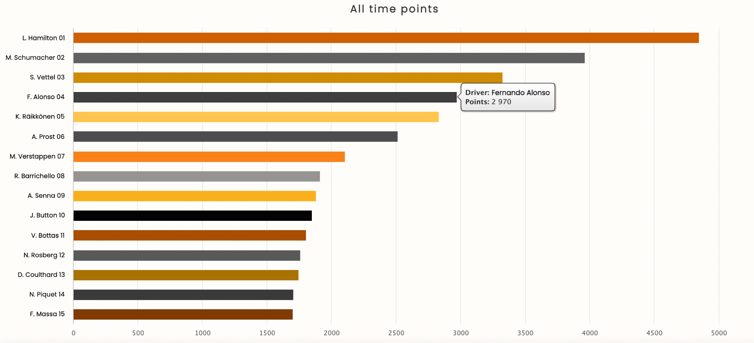
Top 10: Drivers

Slide 14
Team Reflection
Something we learned about data analytics after taking this course is the importance of data preparation.
Specifically, two aspects of data preparation:
The amount of time data preparation takes.
2) The amount of power the data scientists has when preparing the data.
For example, if you decide to handle missing values or outliers in an inappropriate manner the results can be completely skewed, inflated, or deflated.

